Slide 1
Ted Nelson

Slide 2
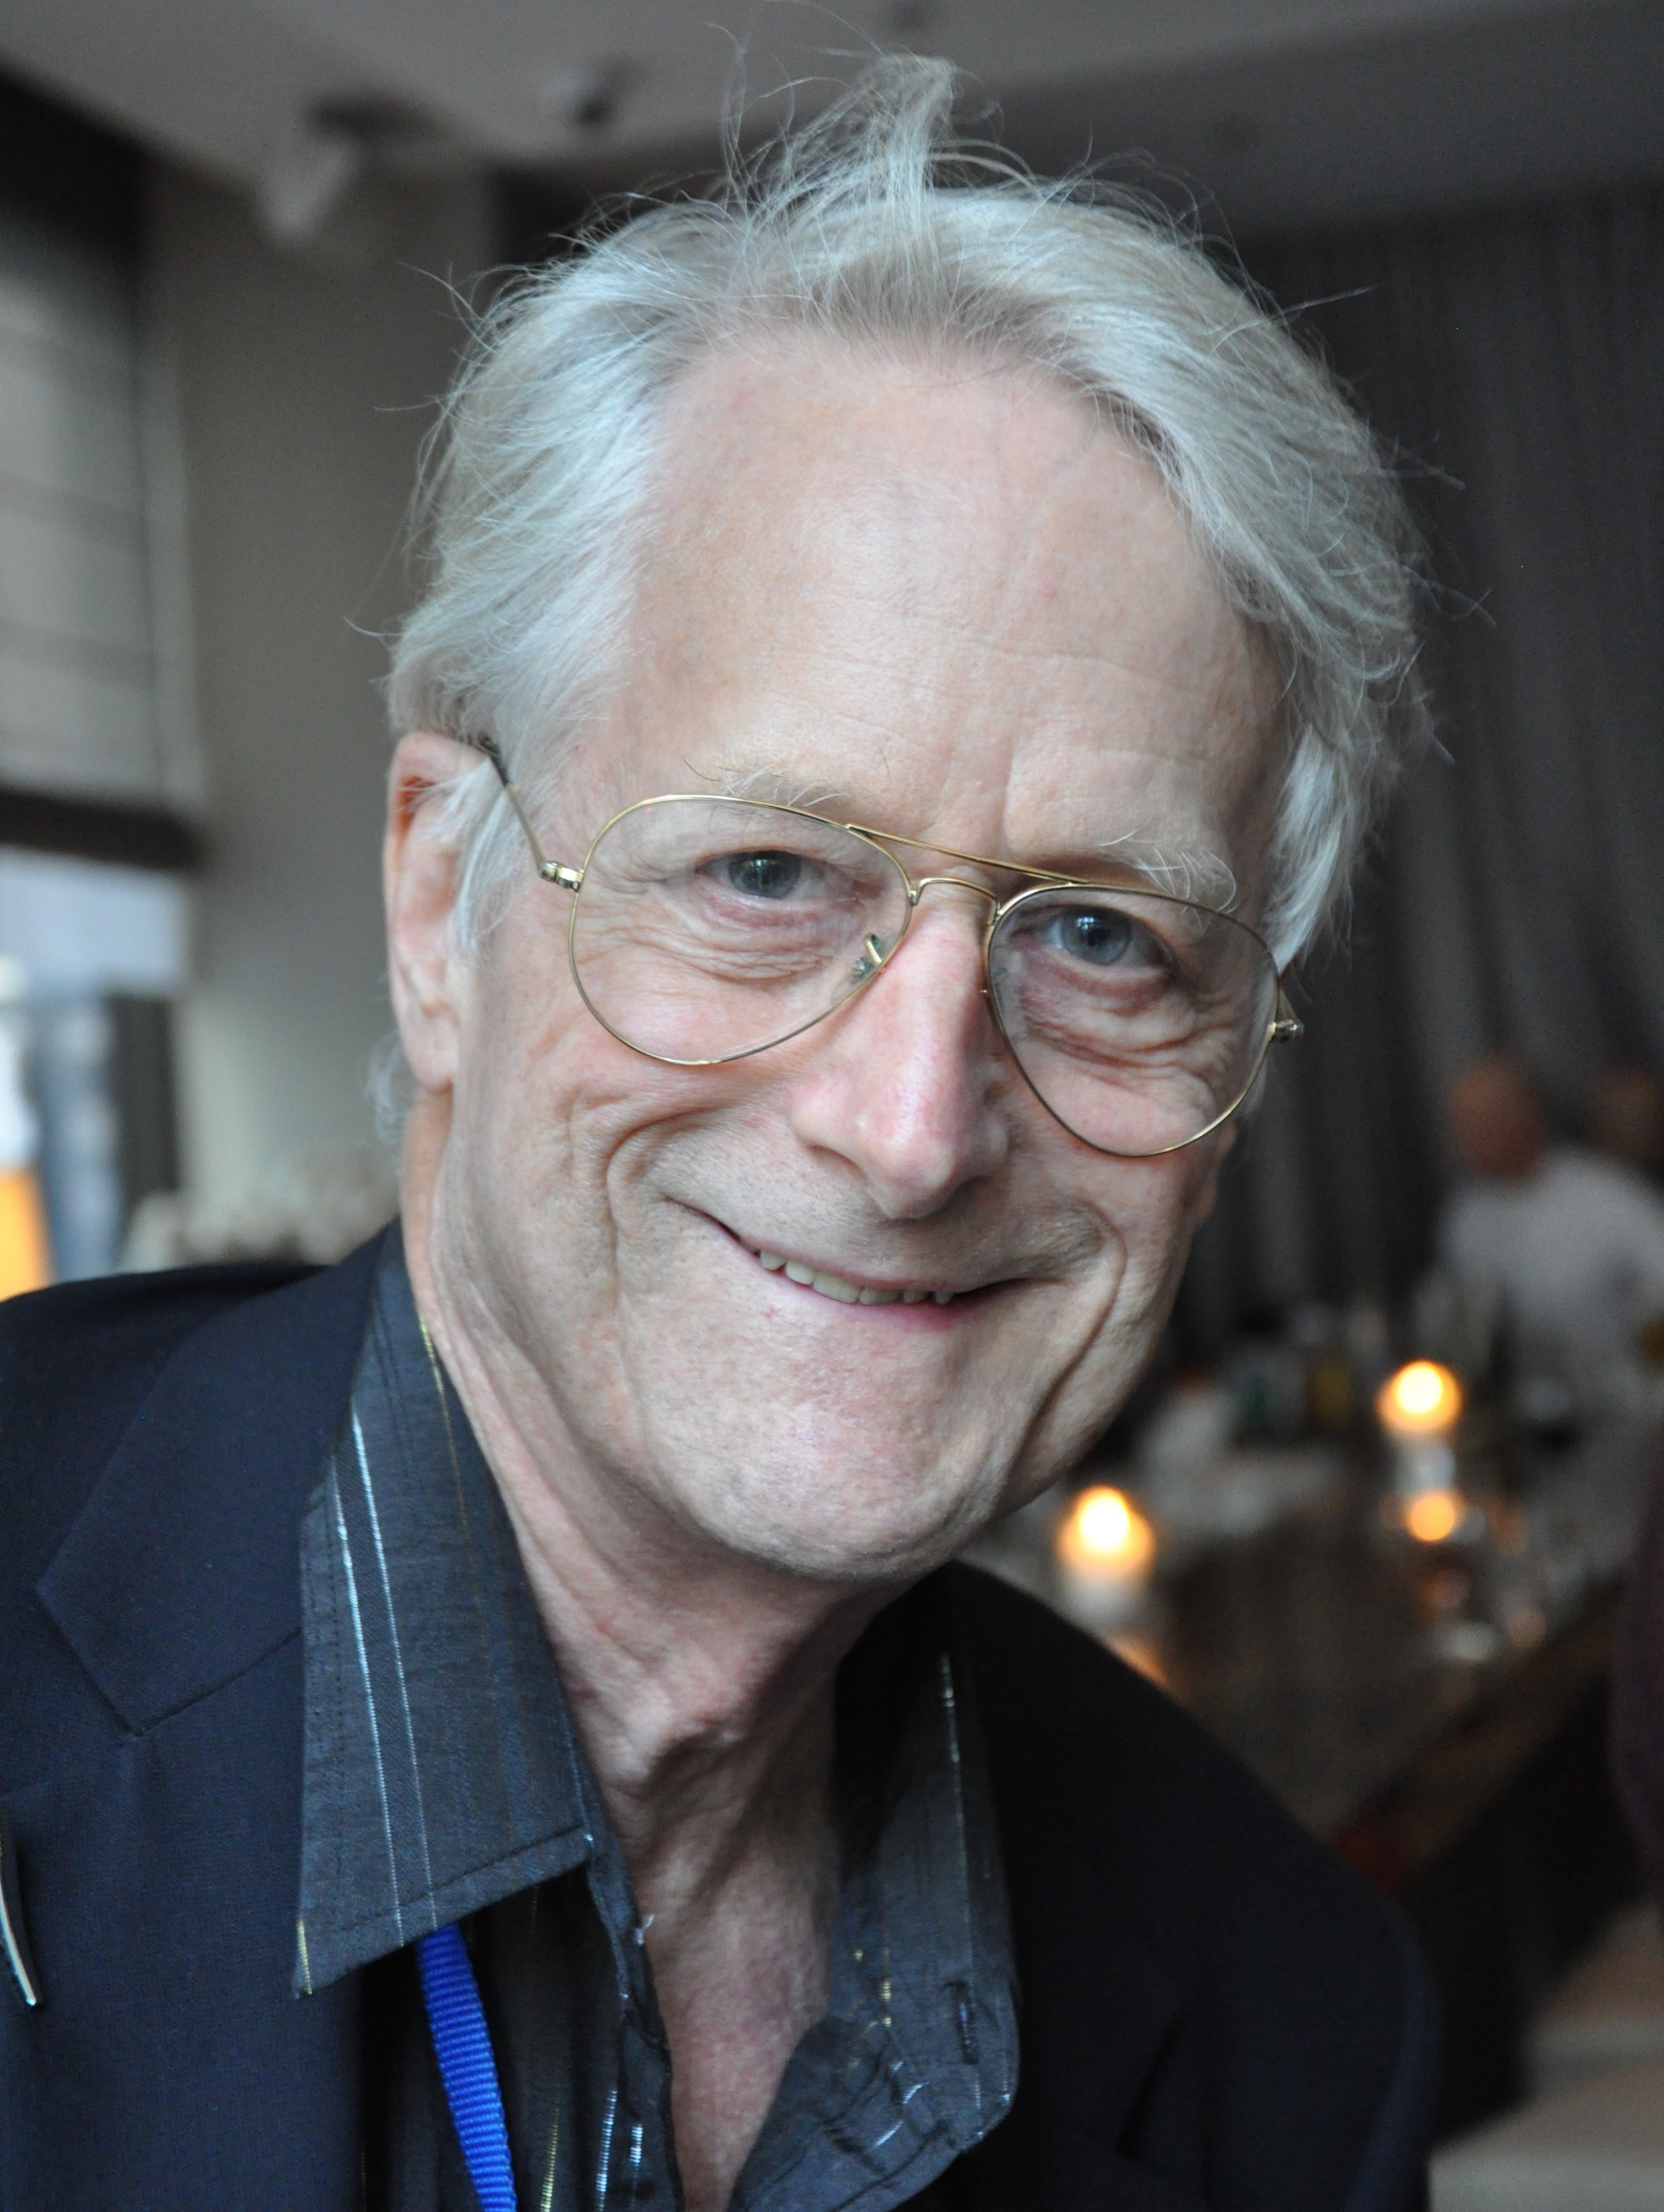
American Pioneer of information technology, philosopher and sociologist
Born June 17, 1937 in Chicago Illinois
He is the son of Director Ralph Nelson and Celeste Holm
Known for Hypertext

Slide 3
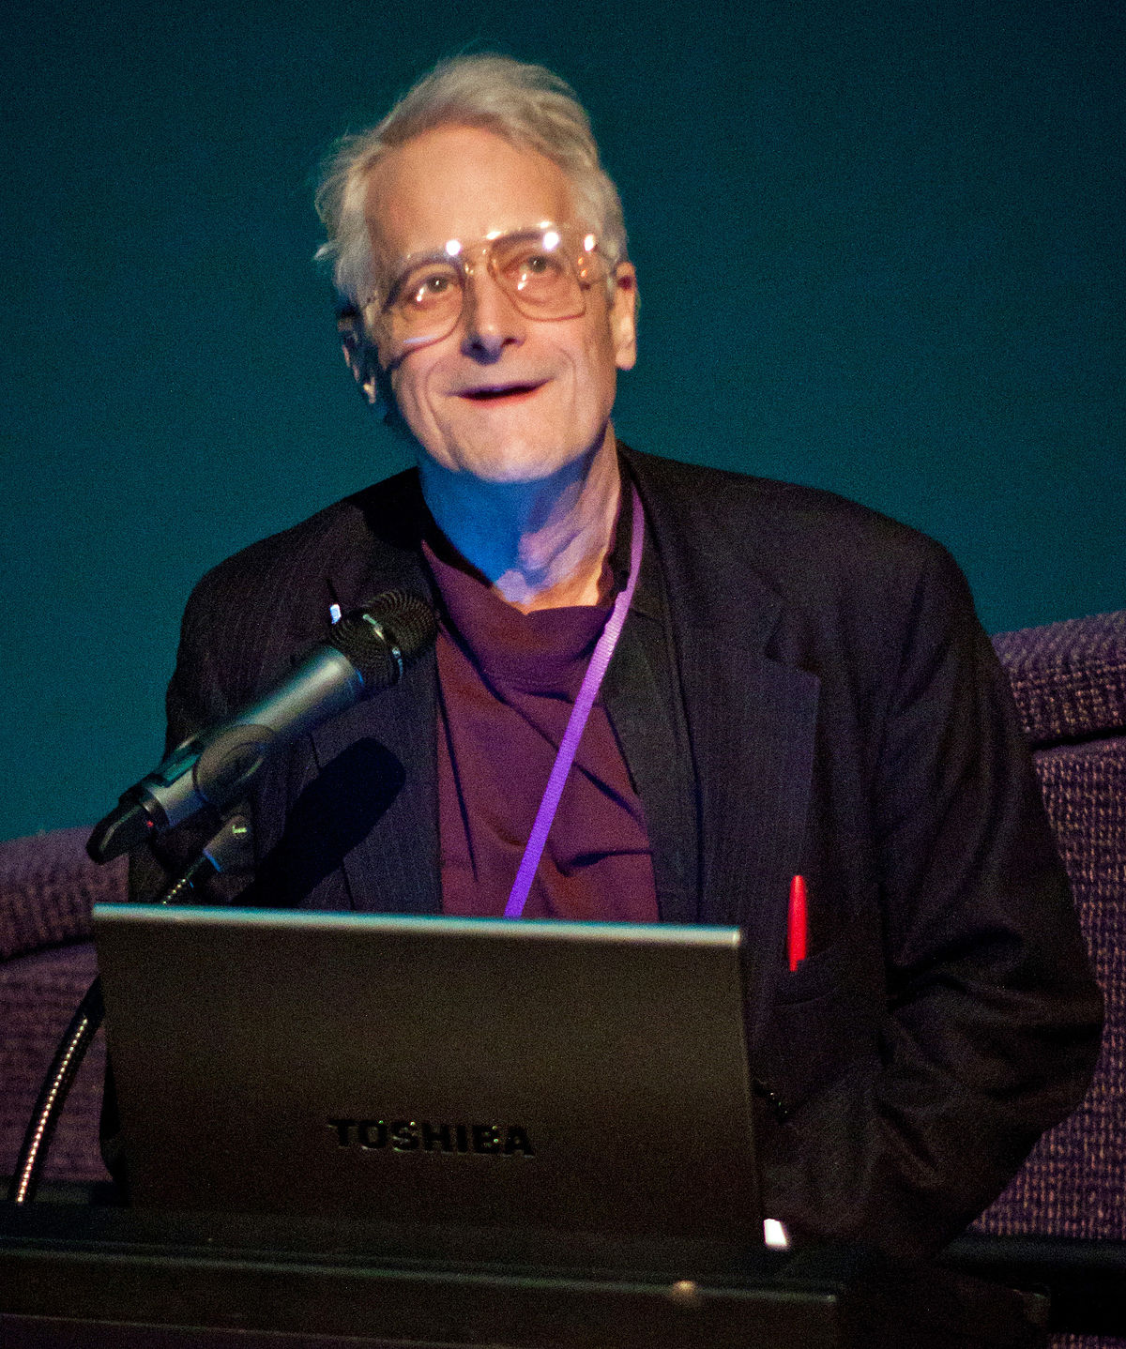
Education
Received his BA from Swarthmore College in 1959
Earned his master degree from Harvard University in sociology
In 2002 he got his Doctorate in Media and Governance from Keio University
Envisioned the Project Xanadu during his time at College and Grad School

Slide 4
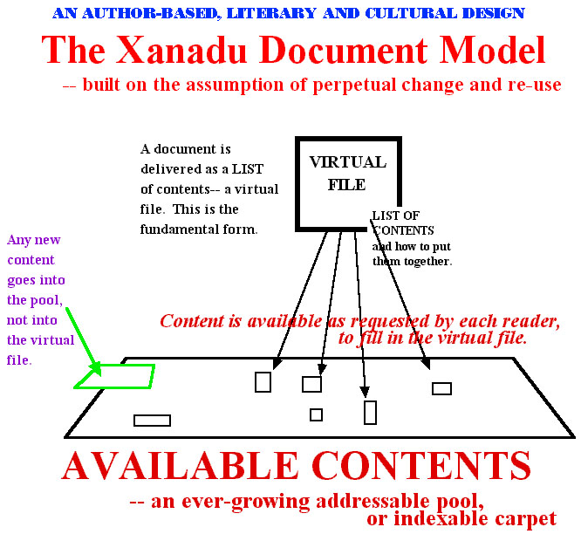
Project Xanadu
Notes:
Proposed the idea in 1960 when he was still in Harvard Grad school, to be a machine language program where it would store and display content and the ability to be able to edit.
At the time, the proposal were interesting to the researchers, but Nelson himself did not have the technical knowledge to implement his idea into real world use. It was the first hypertext project and how the word processor came to be.

Slide 5
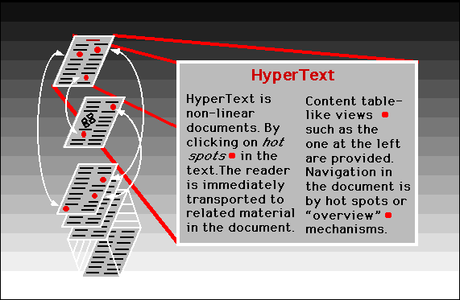
Notes:
Ted Nelson personally coined the terms Hypertext and Hypermedia in 1965.

Slide 6
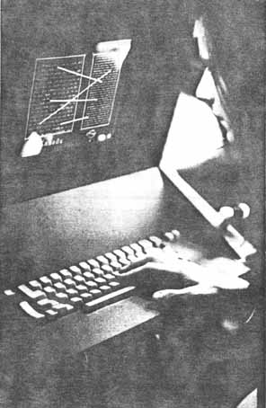
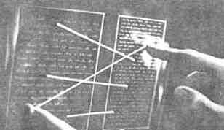
http://xanadu.com/xanademos/MoeJusteOrigins.html
Notes:
Later, In 1980, he found stable financial support from Autodesk, and went under full development phase, where a completed version of software was written in C programming Language.
Though completed, it wasn’t the way they wanted it to work. After much struggle during the development, in 2007, Project Xanadu released Xanaduspace1.0. and in 2014, a version was made available to the internet.

Slide 7
Every Xanadu server is uniquely and securely identified.
Every Xanadu server can be operated independently or in a network.
Every user is uniquely and securely identified.
Every user can search, retrieve, create and store documents.
Every document can consist of any number of parts each of which may be of any data type.
Every document can contain links of any type including virtual copies ("transclusions") to any other document in the system accessible to its owner.
Links are visible and can be followed from all endpoints.
Permission to link to a document is explicitly granted by the act of publication.
Every document can contain a royalty mechanism at any desired degree of granularity to ensure payment on any portion accessed, including virtual copies ("transclusions") of all or part of the document.
Every document is uniquely and securely identified.
Every document can have secure access controls.
Every document can be rapidly searched, stored and retrieved without user knowledge of where it is physically stored.
Every document is automatically moved to physical storage appropriate to its frequency of access from any given location.
Every document is automatically stored redundantly to maintain availability even in case of a disaster.
Every Xanadu service provider can charge their users at any rate they choose for the storage, retrieval and publishing of documents.
Every transaction is secure and auditable only by the parties to that transaction.
The Xanadu client–server communication protocol is an openly published standard. Third-party software development and integration is encouraged.

Slide 8
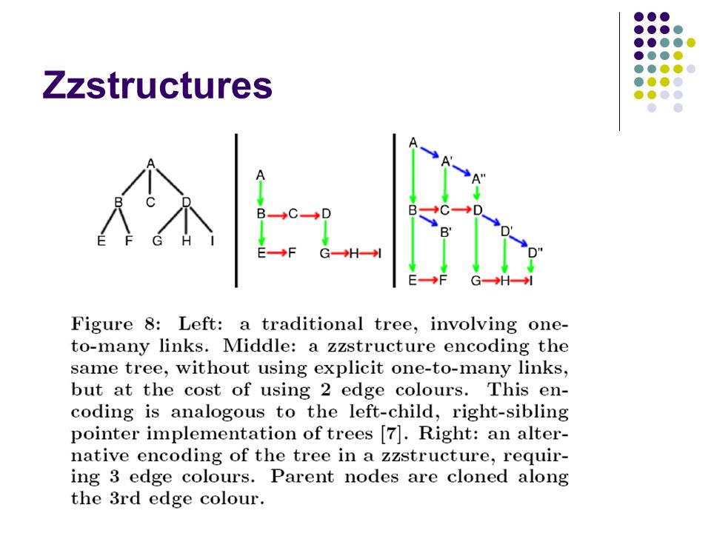
Other Projects
https://www.youtube.com/watch?v=WEj9vqVvHPc
Notes:
2011, he was working on new information structure called zigzag (zzstructure), which hosts two version of Xanadu code. Along with Xanaduspace, system that explores connected parallel documents.

